Slide 1
Business & Financial Plan for Drizzling Investments
Ian Ki-Hoon Suh
Penn State University
Notes:
Hello, My name Ian Ki-Hoon Suh. Welcome to this presentation of my business plan and financial plan for the intended enterprise.

Slide 2

Business Description
Drizzling Investment will be the name of the business.
They business will be a social enterprise.
Notes:
The business will be called Drizzling investment and will be a social enterprise type of business. The main aim of starting the business will be to ensure continuous availability of clean water to the community members.

Slide 3

Product Selling
Purification of water
Distribution of drinking water
Notes:
The business will mainly concentrate in purification of water. Additionally, the business will also be distributing the purified drinking water to the different parts of the target market.

Slide 4

Target Market
Institutions
Public and private offices
Local community
Notes:
The business majorly targets to sell the purified water to institutions including schools and healthcare facilities. Additionally, the business also intends to sell the purified water to public and private offices and also to the local community.

Slide 5

Source of Raw Materials
Nearby Clean water sources
Rooftops
Notes:
The business will be purifying clean water that will be sourced from the nearby clean water bodies. Additionally, the business will also seek to get water that is collected from rooftops for purification also.

Slide 6
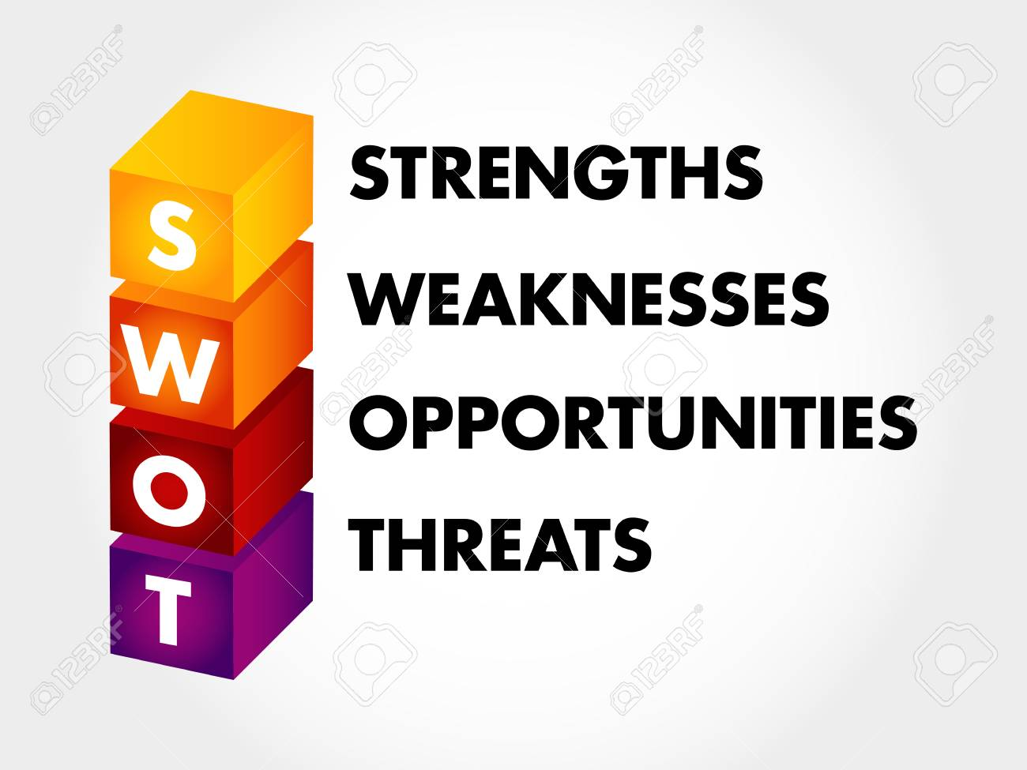
SWOT Analysis: Strengths
Capital strength
Active Management
Marketing strength
Notes:
The enterprise will continuously be maintaining a strong capital base. The entire management team of the business will be aggressive and remain focused on the business goal. Additionally, the enterprise prides itself on a unique and robust strategy for marketing.

Slide 7

SWOT Analysis: Weaknesses
Knowledge
Capital for a start-up
Trust
Notes:
Most of the employees that the enterprise will hire will have robust experience in purification and distribution but lack experience in social entrepreneurship. The enterprise is a capital intensive venture hence needs reliable financial back-up. Also, due to humble beginnings, there is low chances of trust among most of the key stakeholders.

Slide 8

SWOT Analysis: Opportunities
Activism
Self-help
Donors
Notes:
The enterprise will consider having activists to assist in pushing for activities. The enterprise will consider its beneficiaries as part of the business implementation. Due to how the project will be community-based, the enterprise will have the opportunity to get valuable donors quickly.

Slide 9

SWOT Analysis: Threats
Adverse political environment
Stiff Competition
Technological weaknesses
Notes:
Some of the political environments might affect the enterprise especially on capital acquisition. Additionally, there are several enterprises with activities in the areas hence posing threat to the enterprise. Next, there are some advanced technologies that are necessary but the business cannot acquire as at now.

Slide 10
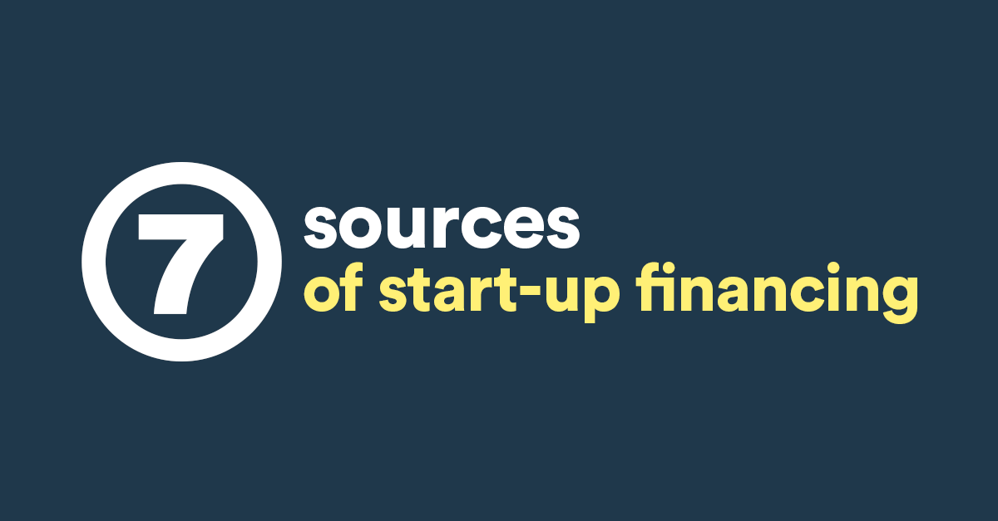
Initial Financials: Initial Capital
First year and second year start up capital of $500,000
Donors
Notes:
The enterprise will have an initial capital of $500,000 that is intended to help the business for the first and second year of investments. Additionally, the enterprise will be aggressive in looking for private donors to donate more capital to the business.

Slide 11

Initial Financials: Assumptions
Favorable economy
Availability of donors
10% interest rate
Notes:
Several assumptions have been made when coming up with the initial financials of the enterprise. First, the enterprise assumes that the economy will be favorable so that all activities are carried out. Additionally, it assumes that there will be many donors available in the local community. Lastly, the enterprise also assumes that the interest rate will be ranging around 10% for the first two tears.

Slide 12

Initial Financials: Expenditure
Rent
Utilities
Employees’ Salaries
Training
Taxes
Marketing
Notes:
Since it’s a start up business, the enterprise projects to incur several expenditures including rent, utilities, employees’ salaries, training, taxes, and marketing. More capital will be allocated to the marketing department to ease the process of looking for new business.

Slide 13

Initial Financials: Depreciation Cost
Low depreciation
Notes:
For the first two years, the depreciation cost is predicted to be low to the extend of being insignificant.

Slide 14

Target Labor Force
Local community youths
Notes:
Since the enterprise will serve the local community, there is need to involve the community members in the process of implementation. The enterprise targets the youths will the community to be the first source of labor force.

Slide 15
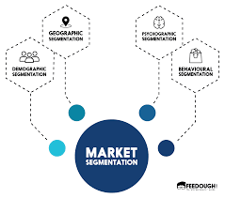
Market Segmentation
Aged Population
Wholesalers
Retailers
Notes:
The market will be divided into three major segments that is aged population, wholesalers and retailers. The aged population will have their bottled water delivered physically to their locations. The wholesalers will either have their orders delivered or visit the enterprise to collect their order. The enterprise will deliver bottled water to the local retailers.

Slide 16

Funding Model and Scalability Plan
External funding
Yearly subscription
Notes:
For the first two years of operation, the business will much depend on external funding.. The community members will be persuaded to become stakeholders. The stakeholders will be required to re-subscribe annually to ensure continuous funding.

Slide 17

Stakeholder Benefits
Subsidized prices
Notes:
Membership to the enterprise will accrue some benefits including subsidized prices. The members will be able to receive some dividends at the end of every financial years as an appreciation token.

Slide 18

Staffing
Management
Purification employees
Drivers
Casual workers
Notes:
The staff of the enterprise will include management team, a team that will be involved in water purification, drivers to deliver orders and casual workers who will be tasked with packaging, loading and offloading vehicles.

Slide 19

Enterprise Goals
Ensure availability of clean water
Capture a bigger market share
Increase profit margin
Provide more employment opportunities to the community
Provide better customer service
Notes:
The enterprise has several objectifies that it intends to achieve. Since it is a social entrepreneurship form of business, it intends to ensure availability of clean water to the community, provide more job opportunities to the community members, increase profit margins, offer better customer service, and capture a bigger market share.

Slide 20
References
Berry, T. (2020, January 2). A Standard Business Plan Outline [Updated for 2020] | Bplans. Bplans Blog. https://articles.bplans.com/a-standard-business-plan-outline/
SWOT Analysis. (2019, July 2). REDFworkshop. https://redfworkshop.org/tool/swot-analysis/
Sector, F. (2007). A business planning guide for developing a social enterprise. Dalam www. forthsector. org. uk.
Notes:
This marks the end of the presentation. For more information about the business plan, kindly visit the above references. Thank you for your time

